Slide 1
Software Quality Engineering
Lecture 2
SQA Plan and Development Plan
Alina Arshad
alina.arshad@nu.edu.pk

Slide 2
Introduction
Development and quality standards (ISO 9000.3 and CMM) require viable plans. We need to look at development plans and quality plans – their objectives and elements.
The main goal of a development plan is to outline how a project or product will be created, Scope, Schedule, Resources, Budget, Tasks and Deliverables.
A quality plan is about ensuring that the final product meets certain standards and is free from defects. It focuses on maintaining and improving the quality of the product throughout its development and after it’s done.
They are related but NOT the same.

Slide 3
Development and Quality Plans - Objectives
Planning is meant to prepare adequate foundations for successful and timely completion of the project. The planning process includes:
Scheduling development activities and estimating the required manpower resources and budget
Implementing required SQA activities
Providing management with data needed for project control

Slide 4
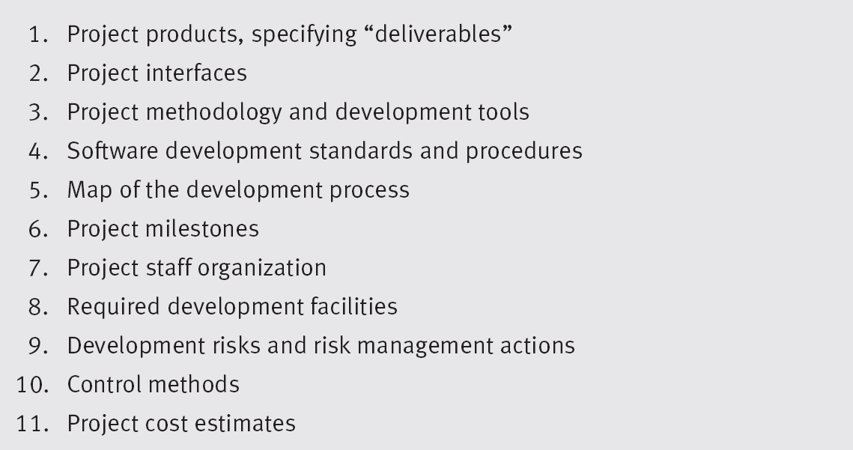
Elements of the Development Plan

Slide 5
Elements of the Development Plan
Project Products, specifying “Deliverables”
Must specify items to be delivered to customer (documents, user manuals)
Must specify specific software products (along with completion and installation dates

Slide 6
Elements of the Development Plan
Project Interfaces
Interfaces with existing software packages (software interface)
(A course enrollment system might interface with an existing Billing System or Course Scheduling System…)
Interfaces with other software

Slide 7
Elements of the Development Plan
Project methodology and development tools
Process tools / environment needed
Requirements capture and technologies used
Design approaches
Testing Approaches etc.
Deployment
Software Development Standards and Procedures

Slide 8
Elements of the Development Plan
Map of the Development Process
Detailed definition of project’s phases:
Estimates of each activity’s duration:
Sequencing and dependency of activities.
List of professional resources needed overall and for each activity.

Slide 9
Elements of the Development Plan
Can use PERT and CPM and other activities to communicate activities, durations, deliverable dates, …
Some like Microsoft Project.
Can use more modern tools too, like IBM’s Rational Team Concert (RTC).

Slide 10
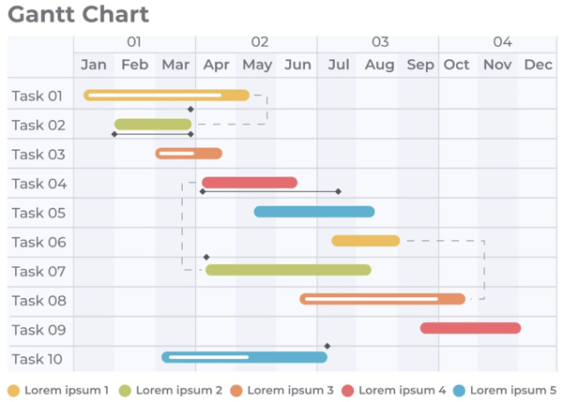
Gantt Chart

Slide 11
Elements of the Development Plan…
Project Milestones
Project staff organization and coordination with external participants
Long term leadership; team losses due to many factors;
Required development facilities
Required hardware, software, tools, space, infrastructure, …

Slide 12
Elements of the Development Plan
Development Risks and Risk Management Actions
Development Risk: “a state or property of a development task or environment, which, if ignored, will increase the likelihood of project failure”.
Risk Areas
Technology Risks – lack of expertise; not correct / needed tools
Environmental Risk:
Interdependence of other organizational elements who supply resources (subcontractors, specialized hardware, etc. )
Notes:
Is it an app for the battlefield? Home?

Slide 13
Elements of the Development Plan
Control methods
Progress reports and coordination meetings are planned to control project implementation
Project Cost Estimates
These are based on proposal cost estimates followed by thorough review and continuous updating.
Changes can/will occur, and these can be major budget impacts, such as subcontractors don’t fulfill their obligations or other unplanned expenditures arise.
Some projects are ‘successes’ but way over budget.
Ultimately, the approval of the development plan will take place within the organization(s).
Notes:
Reference: Software Quality Assurance: from Theory to Implementation. Daniel Galin, Chapter 6, Pearson Education, 2004.

Slide 14
Class Activity 1
George Wise is an exceptional programmer. Testing his software modules reveals very few errors, far fewer than the team’s average. He keeps his schedule promptly, and only rarely is he late in completing his task. He always finds original ways to solve programming difficulties, and uses an original, individual version of the coding style. He dislikes preparing the required documentation, and rarely does it according to the team’s templates.
A day after completing a challenging task, on time, he was called to the office of the department’s chief software engineer. Instead of being praised for his accomplishments (as he expected), he was warned by the company’s chief software engineer that he would be fired unless he began to fully comply with the team’s coding and documentation instructions.
Do you agree with the position taken by the department’s chief software engineer?
If yes, could you suggest why his or her position was so decisive?

Slide 15
Concluding remarks
SQA is an umbrella activity which is employed throughout the software lifecycle.
Software quality assurance is very important for your software product or service to succeed in the market and survive up to the customer’s expectations.
There are various activities, standards, and techniques that you need to follow to assure that the deliverable software is of high quality and aligns closely with the business needs

Slide 16
Any question????

